Slide 1
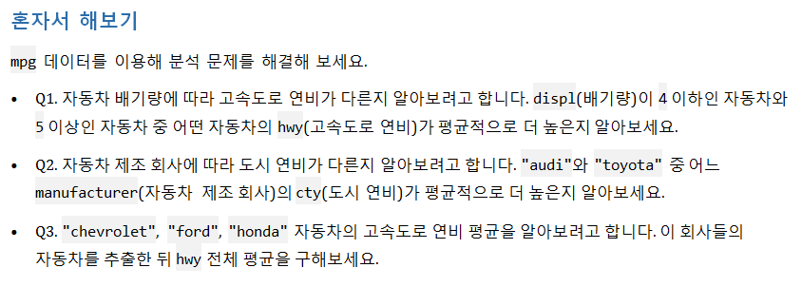


Slide 2
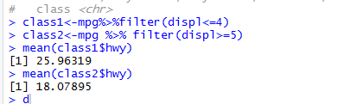
1번 문제
(ggplot2 library를 불러옴!!)
mpg<-as.data.frame(ggplot2::mpg)
mpg
class1<-mpg%>%filter(displ<=4)
class2<-mpg %>% filter(displ>=5)
mean(class1$hwy) ➔배기량이 4 이하인 자동차가 hwy 가 더 크다
mean(class2$hwy)

Slide 3
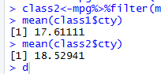
2번문제
class1<-mpg%>%filter(manufacturer=="audi")
class2<-mpg%>%filter(manufacturer=="toyota")
mean(class1$cty)
mean(class2$cty) →toyota가 도시연비가 평균적으로 더 높다

Slide 4
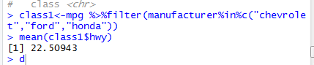
3번문제
class1<-mpg %>%filter(manufacturer%in%c("chevrolet","ford","honda"))
mean(class1$hwy)

Slide 5
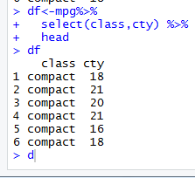
df<-mpg%>%
select(class,cty) %>%
head
df

Slide 6
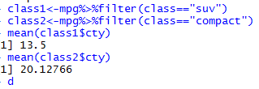
class1<-df%>%filter(class=="suv")
class2<-df%>%filter(class=="compact")
mean(class1$cty)
mean(class2$cty) →class 가 compact 인 자동차의 도시연비가 크다.

Slide 7



Slide 8
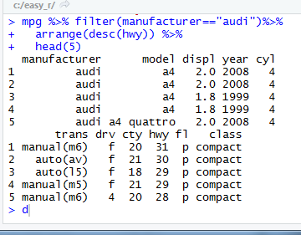
mpg
mpg %>% filter(manufacturer=="audi")%>%
arrange(desc(hwy)) %>%
head(5)

Slide 9
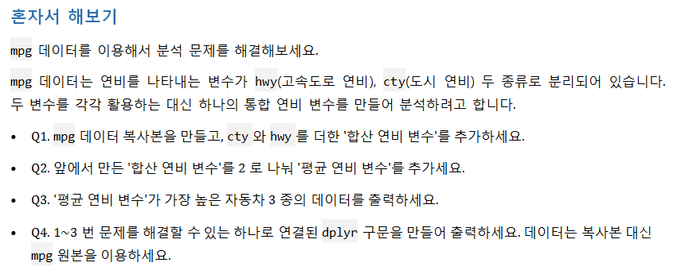


Slide 10
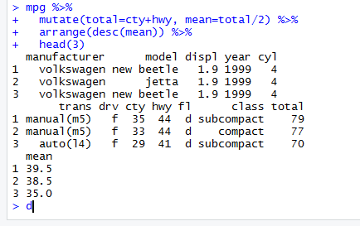
1번
mpg<-as.data.frame(ggplot2::mpg)
mpg_new<-mpg ->복사본 만들기
mpg_new<-mpg_new%>%mutate(total=hwy+cty)
2번
mpg_new<-mpg_new%>%mutate(mean=total/2)
3번
mpg_new%>%arrange(desc(mean)) %>%
head(3)
4번
mpg %>%
mutate(total=cty+hwy, mean=total/2) %>%
arrange(desc(mean)) %>%
head(3)

Slide 11
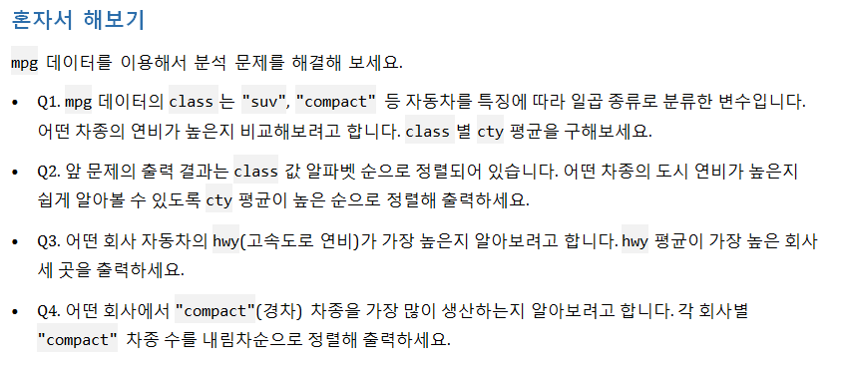


Slide 12
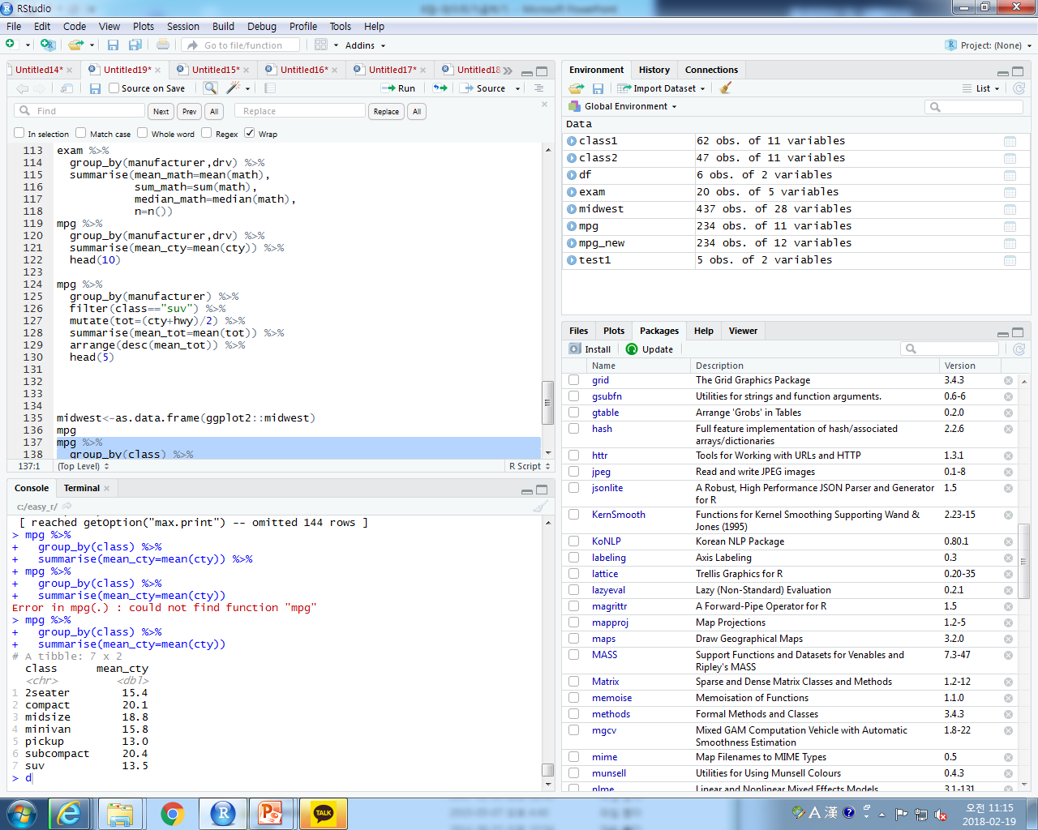
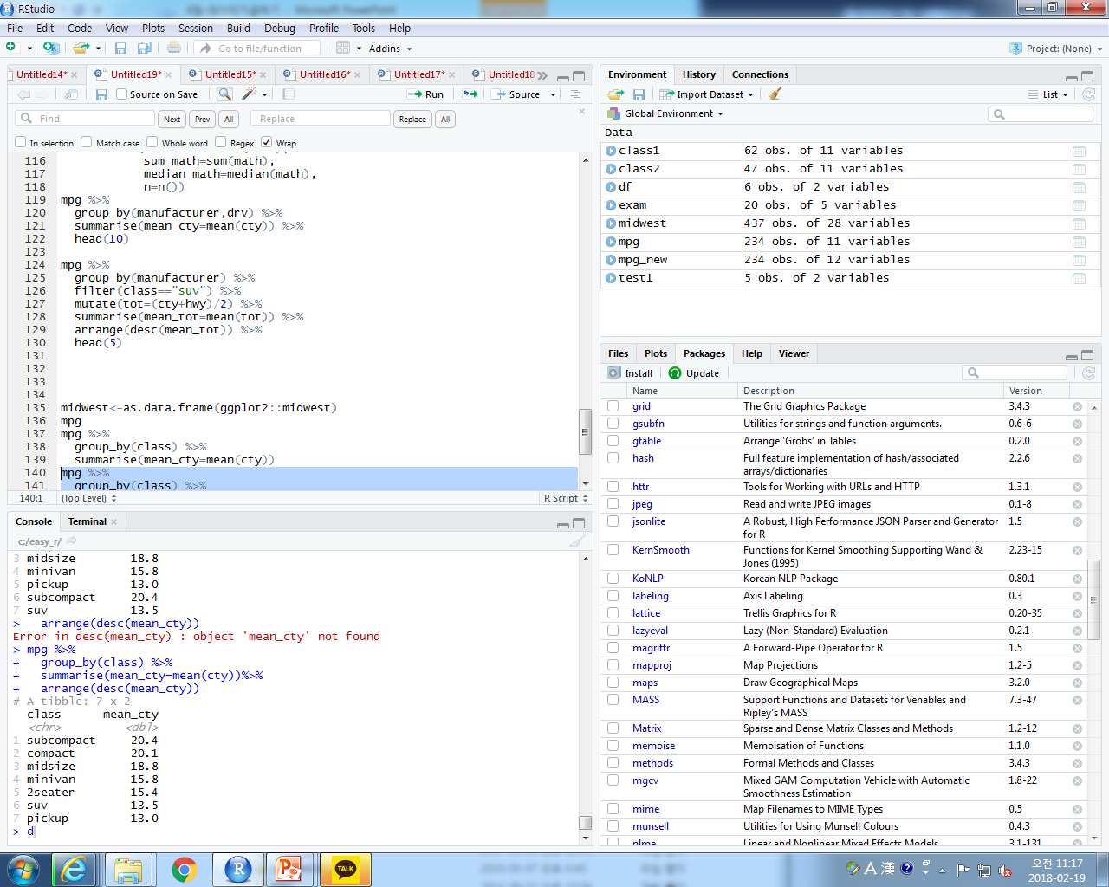
1번
mpg %>%
group_by(class) %>%
summarise(mean_cty=mean(cty))
2번
mpg %>%
group_by(class) %>%
summarise(mean_cty=mean(cty))%>%
arrange(desc(mean_cty))

Slide 13
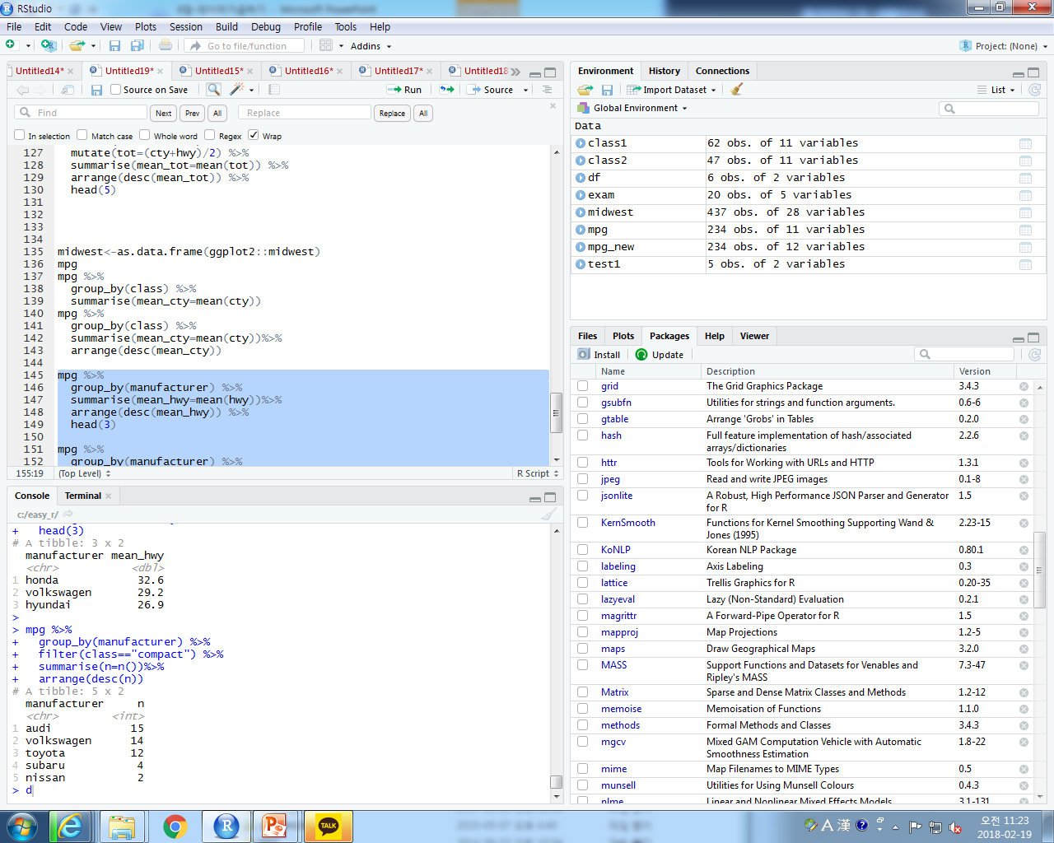
3번
mpg %>%
group_by(manufacturer) %>%
summarise(mean_hwy=mean(hwy))%>%
arrange(desc(mean_hwy)) %>%
head(3)
4번
mpg %>%
group_by(manufacturer) %>%
filter(class=="compact") %>%
summarise(n=n())%>%
arrange(desc(n))

Slide 14
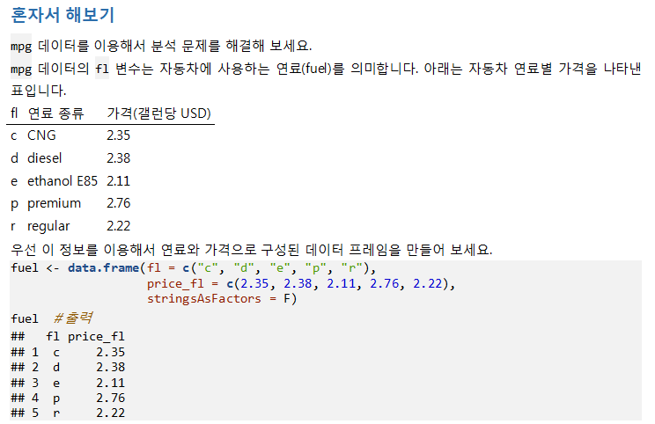


Slide 15
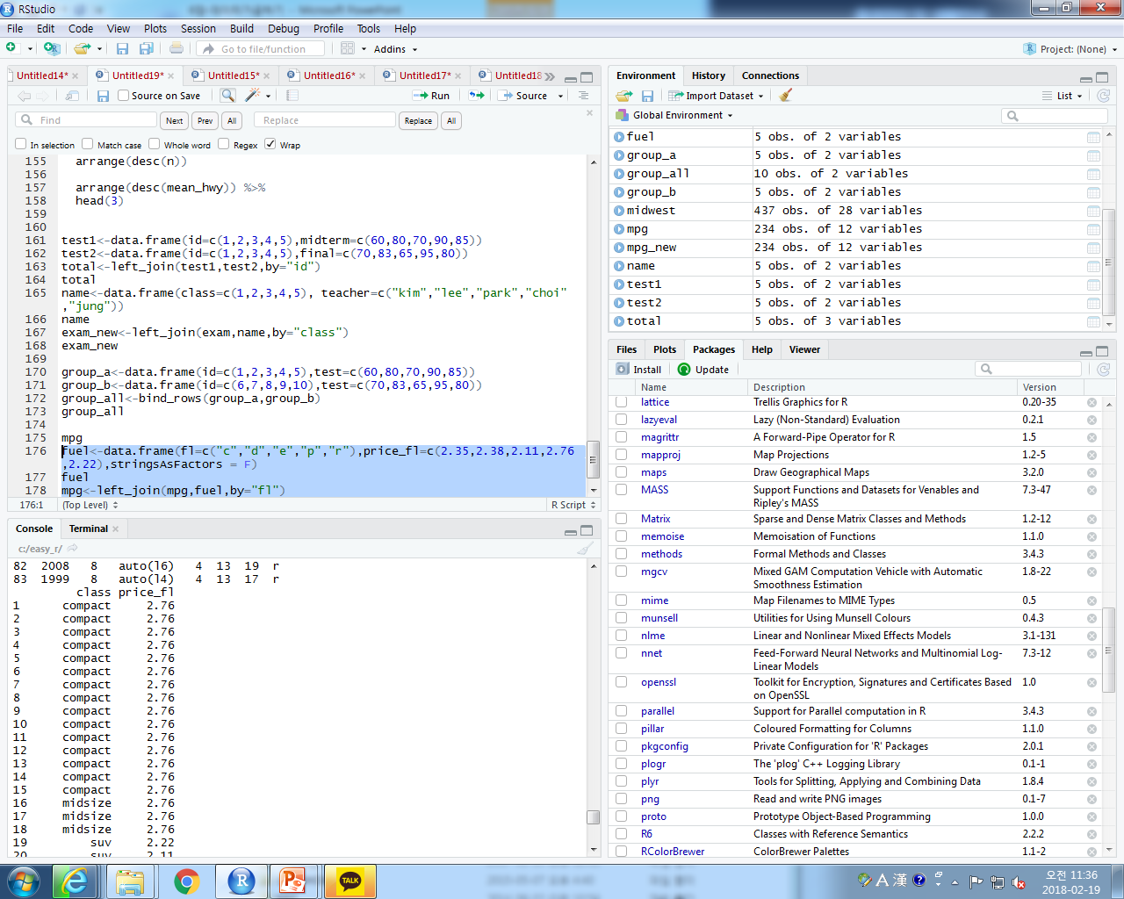
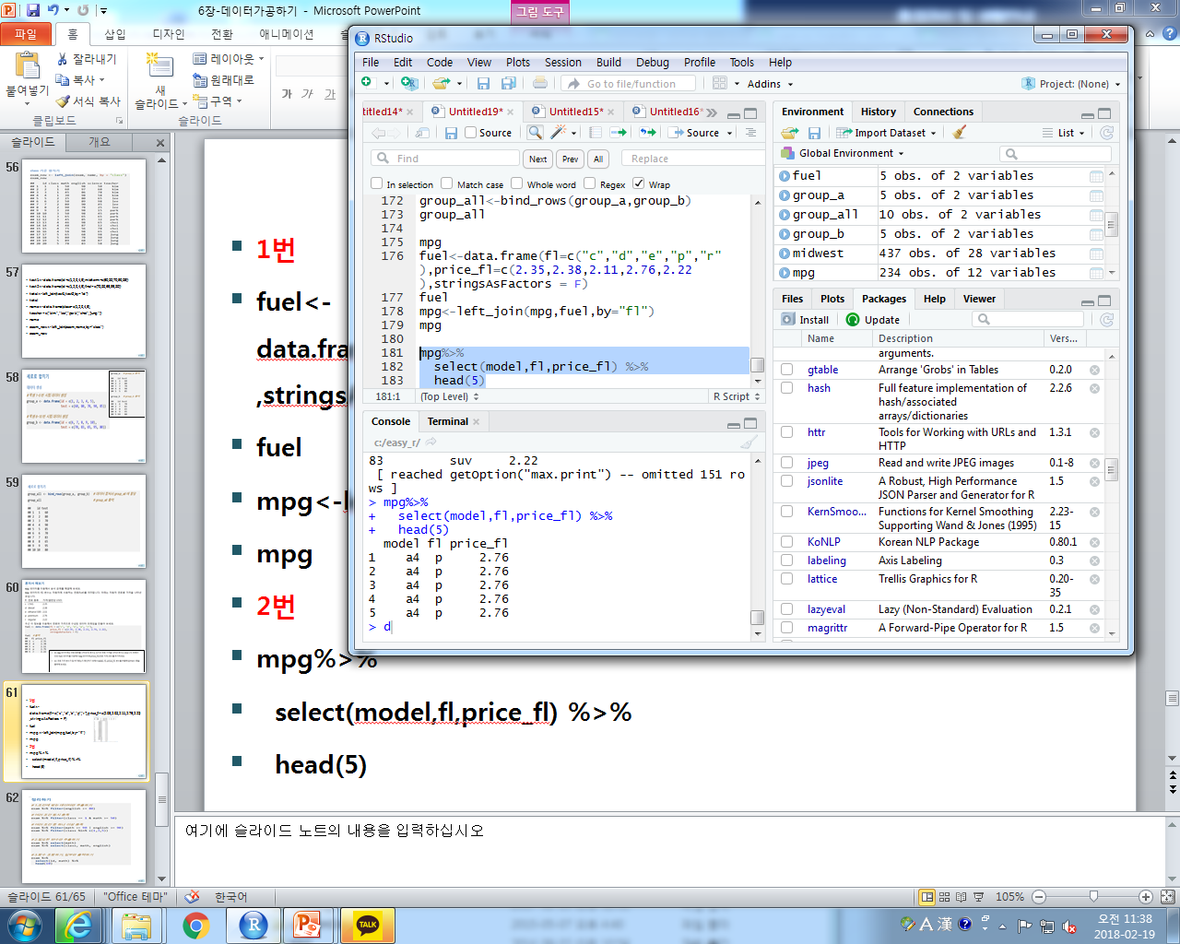
1번
fuel<-data.frame(fl=c("c","d","e","p","r"),price_fl=c(2.35,2.38,2.11,2.76,2.22),stringsAsFactors = F)
fuel
mpg<-left_join(mpg,fuel,by="fl")
mpg
2번
mpg%>%
select(model,fl,price_fl) %>%
head(5)

Slide 16
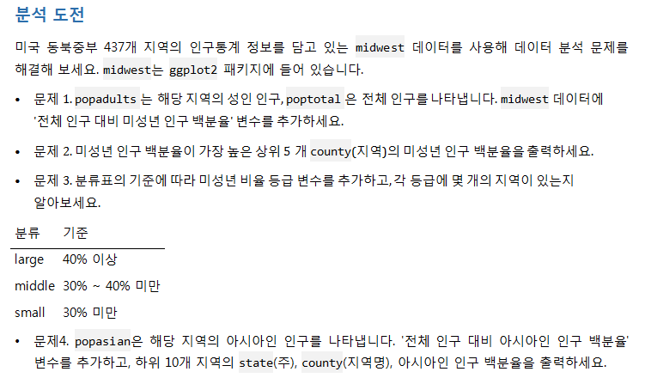

Slide 17
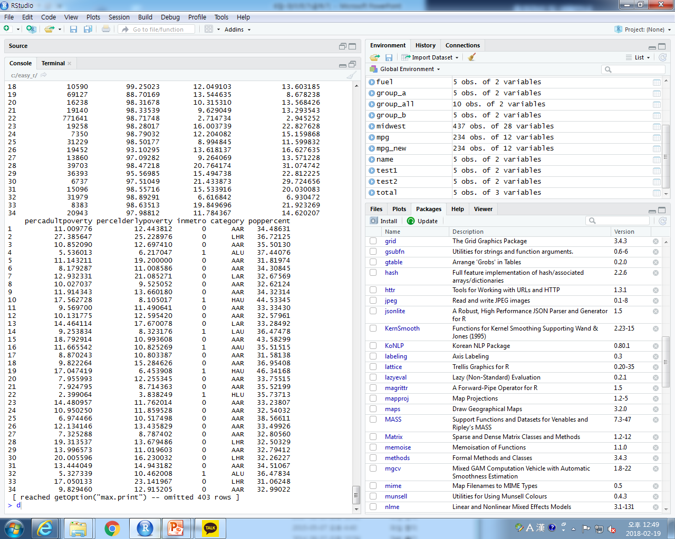
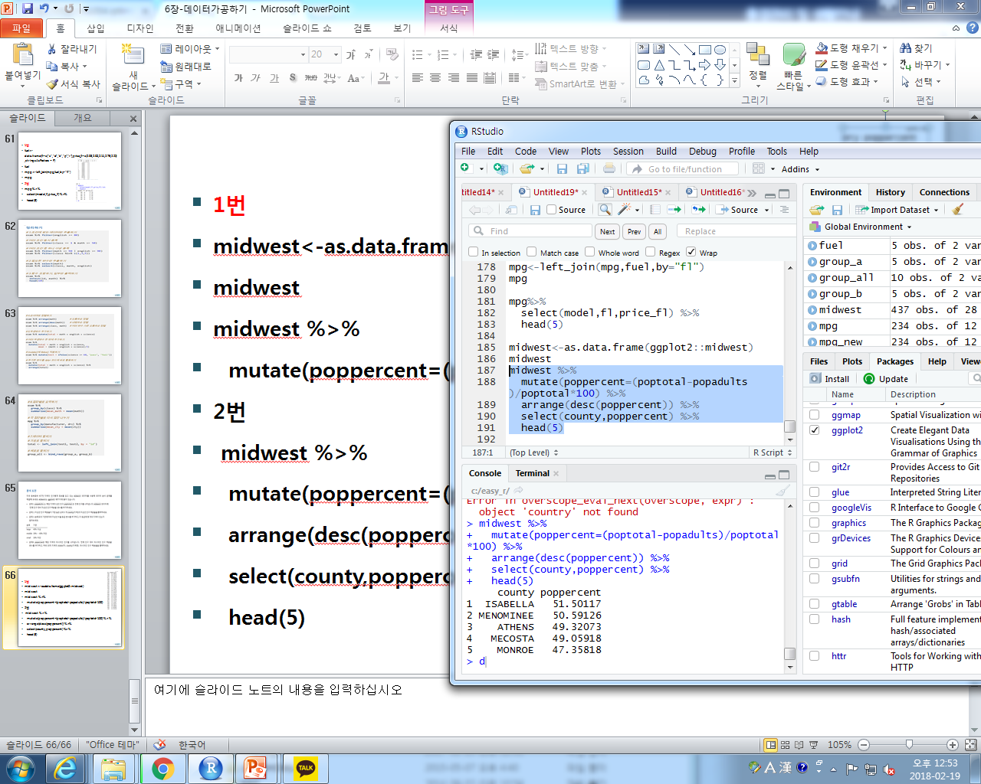
1번
midwest<-as.data.frame(ggplot2::midwest)
midwest
midwest %>%
mutate(poppercent=(poptotal-popadults)/poptotal*100)
2번
midwest %>%
mutate(poppercent=(poptotal-popadults)/poptotal*100) %>%
arrange(desc(poppercent)) %>%
select(county,poppercent) %>%
head(5)

Slide 18
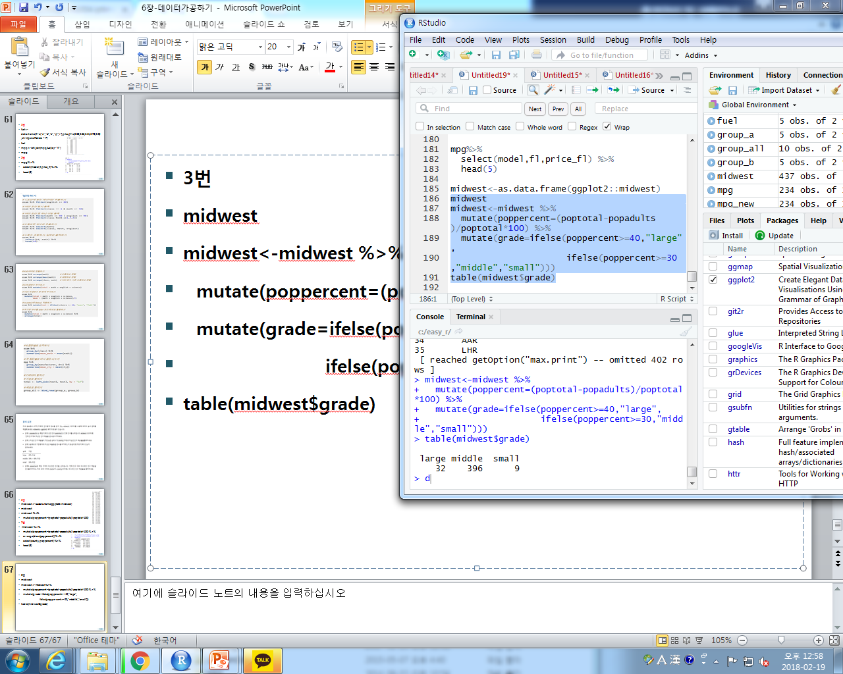
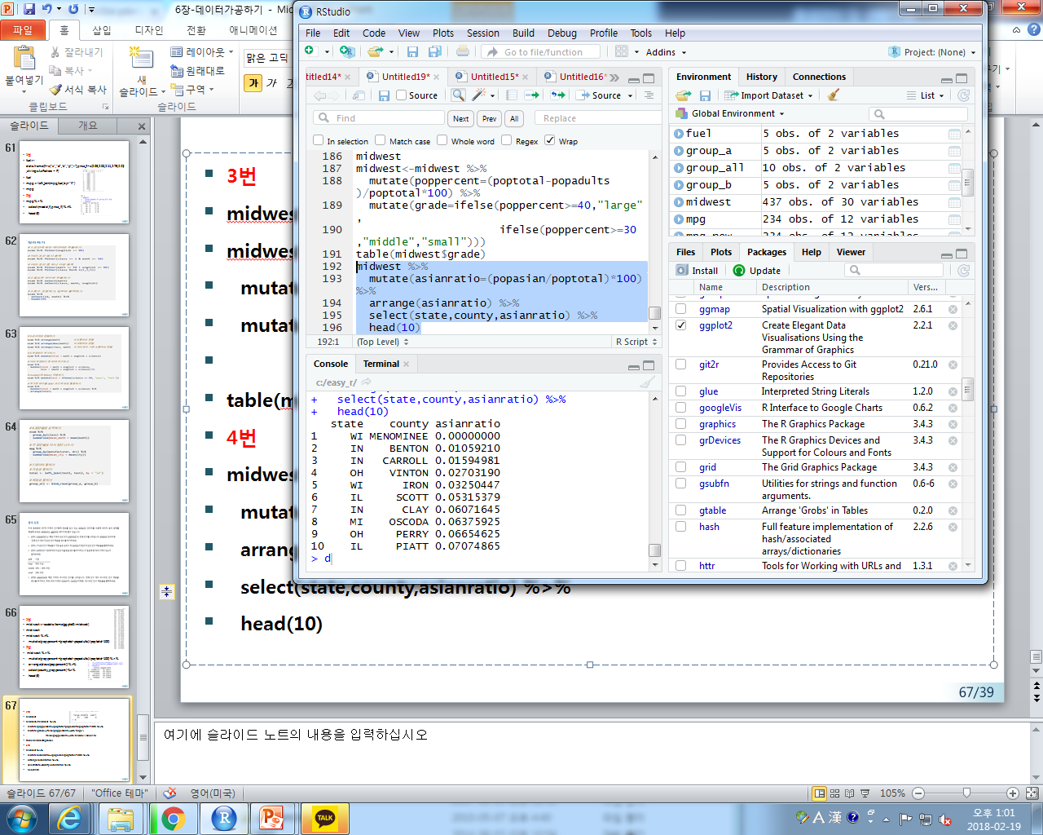
3번
midwest
midwest<-midwest %>%
mutate(poppercent=(poptotal-popadults)/poptotal*100) %>%
mutate(grade=ifelse(poppercent>=40,"large",
ifelse(poppercent>=30,"middle","small")))
table(midwest$grade)
4번
midwest %>%
mutate(asianratio=(popasian/poptotal)*100) %>%
arrange(asianratio) %>%
select(state,county,asianratio) %>%
head(10)

